Slide 1
Session 4 Stratification & Inequality
Xuewen Yan

Slide 2

Equality, equality, and social justice
Sociologists in most OECD countries: More research on equality of opportunity (i.e., equality)
Socialist ideal: Equality of outcome (i.e., equity)

Slide 3

Does equality hinder growth?
Video clip: Thatcher's Last Stand Against Socialism - YouTube

Slide 4
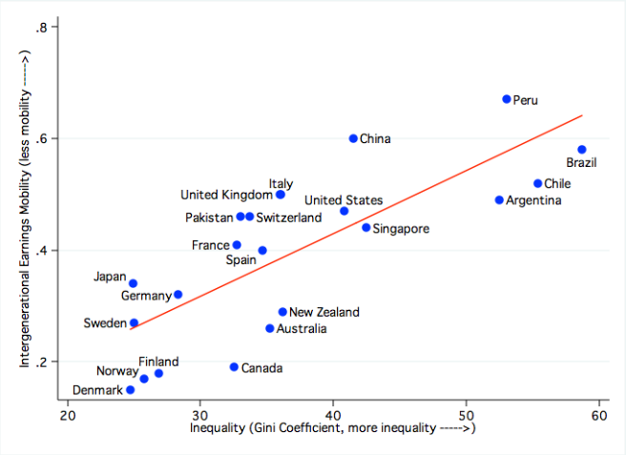
Stylized fact 1: The Great Gatsby Curve

Slide 5
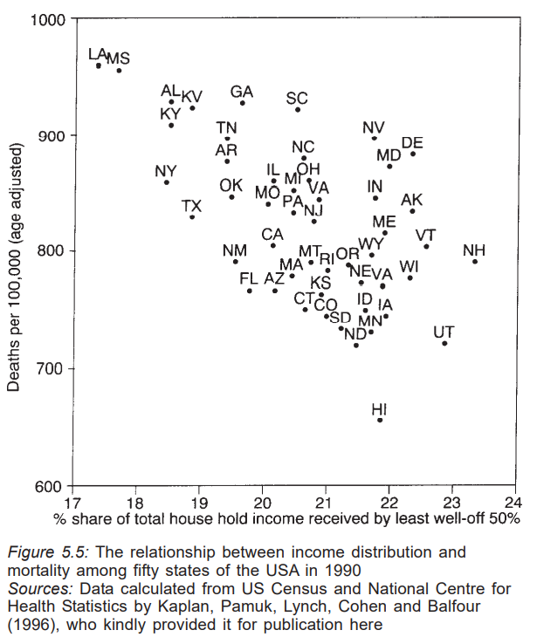
Stylized fact 2: Income inequality and health
Notes:
TWO−LETTER STATE AND TERRITORY ABBREVIATIONS (faa.gov)

Slide 6
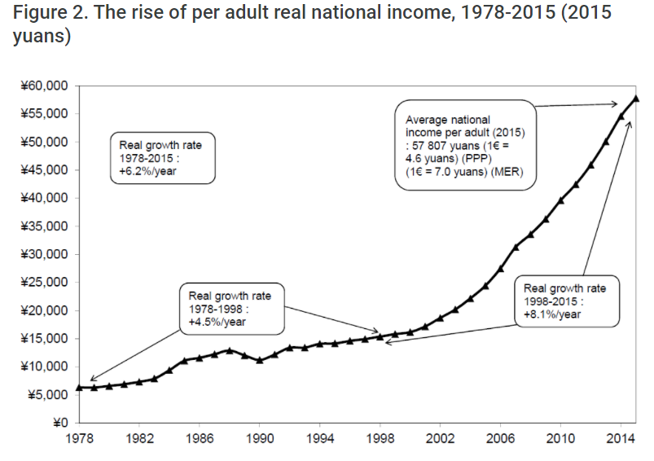
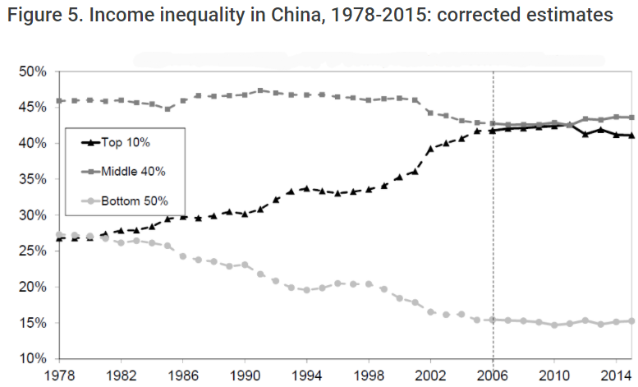
Rise of income & income inequality in China
Source: LSE Business Review

Slide 7
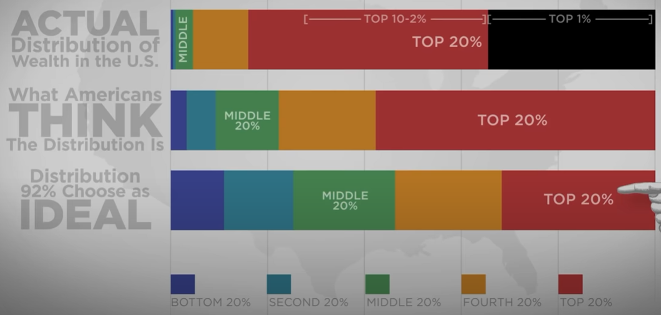
Wealth Inequality in America - YouTube

Slide 8
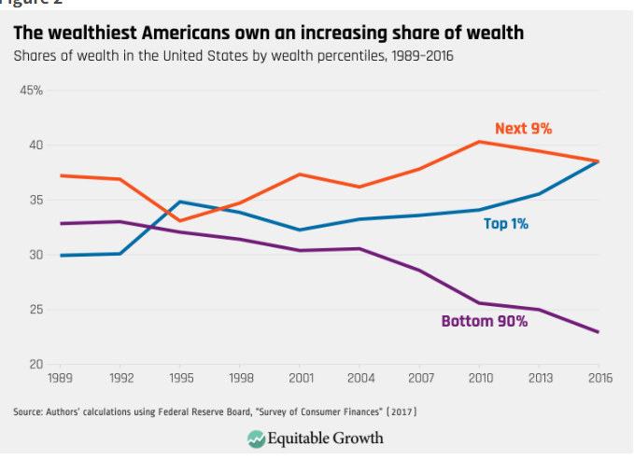
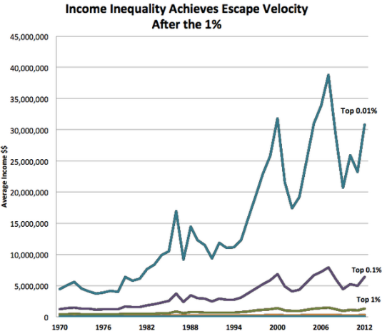

Slide 9
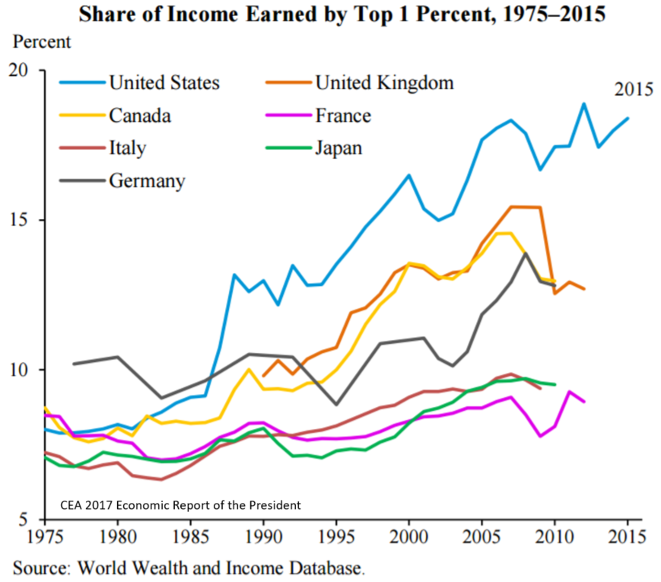

Slide 10
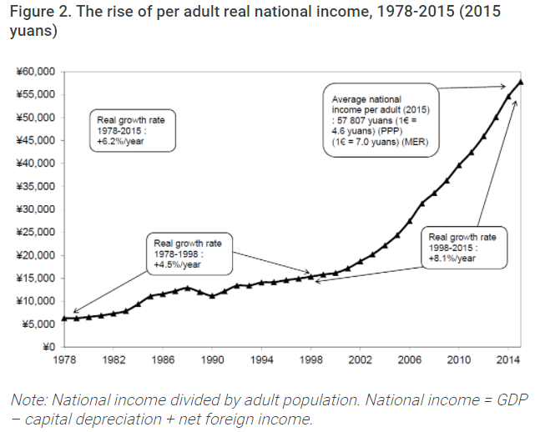

Slide 11
